Slide 1


CHAPTER 2
FOUR OPERATIONS

Slide 2

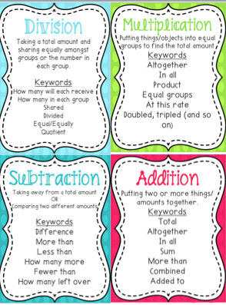
By Four operations in Mathematics, we mean Addition, Subtraction, Multiplication and Division. Mastering them is one of the keys to progressing in understanding of mathematics.
In this Chapter we will learn to perform mathematical operations on larger numbers. First we will learn Addition of larger numbers.

Slide 3

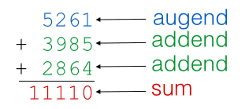
I :- Addition
Addition is the term used to describe adding two or more numbers together. The numbers to be added are called augend and addend. The answer is the sum. Sometimes augend and addend are the same.
In Class IV we have learnt to add 5-digit and 6-digit numbers. Now our objective is to become perfectionists in addition of 7-digit and 8-digit numbers.

Slide 4
In this Power Point Presentation, we will learn
Column Addition
Find the sum by estimating the answers

Slide 5
1 - Column Addition – By Column Addition we mean arranging the augend and addend in correct columns and adding thereafter. Let’s take an example on the same.
Ques: Find the sum of the following using column addition:
1,43,68,752 + 3893 + 26,672

Slide 6
Step 1
Write the columns and arrange the numerals under correct places.
Note : a) After writing all places leave a line blank for writing carry overs.
b) While writing the numbers always start from ones place.
 | C | TL | L | T Th | Th | H | T | O
 | 1 | 4 | 3 | 6 | 8 | 7 | 5 | 2
+ |  |  |  |  | 3 | 8 | 9 | 3
+ |  |  |  | 2 | 6 | 6 | 7 | 2
This is called vertical arrangement of numbers.

Slide 7
In Ones Column: 2 + 3 + 2 = 7
Step 2
In previous classes we learnt that addition always starts
from ones column. The same would be followed here.
In Tens Column: 5 + 9 + 7 = 21. So, 1 will come at tens place and 2 will get carry over.
In Hundreds Column: 2 + 7 + 8 + 6 = 23. So, 3 will come at hundreds place and 2 will get carry over.
 | C | TL | L | T Th | Th | H | T | O
 |  |  |  | 1 | 2 | 2
 | 1 | 4 | 3 | 6 | 8 | 7 | 5 | 2
+ |  |  |  |  | 3 | 8 | 9 | 3
+ |  |  |  | 2 | 6 | 6 | 7 | 2
 | 1 | 4 | 3 | 9 | 9 | 3 | 1 | 7
In Thousands column: 2 + 8 + 3 + 6 = 19. So, 9 will come at thousands place and 1 will get carry over.
In Ten Thousands column:1 + 6 + 2 = 9. So, 9 will come at ten thousands place.
Hence, the answer is 1,43,99,317.
In Lakhs column: We have only 3 at lakhs place, so we will bring it down.
In Ten Lakhs column: We have only 4 at ten lakhs place, so we will bring it down.
In Crores column: We have only 1 at crores place, so we will bring it down.

Slide 8
2 - Find the sum by estimating answers – We will round off the augend and addend to nearest thousands. Then, add them to find the estimated sum.
Ques: Find the sum by estimating to nearest thousands: a) 47,983 + 31,299
b) 9,244 + 18,723

Slide 9
a) 47,983 + 31,299
Step 1:
Round off 47,983 to nearest thousands
47,983 48,000
Step 2:
Round off 31,299 to nearest thousands
31,299 31,000
Step 3:
Find, the required sum
 | T Th | Th | H | T | O
 | 4 | 8 | 0 | 0 | 0
+ | 3 | 1 | 0 | 0 | 0
 | 7 | 9 | 0 | 0 | 0
Hence, the estimated sum is 79,000

Slide 10
b) 9,244 + 18,723
Step 1:
Round off 9,244 to nearest thousands
9,244 9,000
Step 2:
Round off 18,723 to nearest thousands
18,723 19,000
Step 3:
Find, the required sum
 | T Th | Th | H | T | O
 | 1
 |  | 9 | 0 | 0 | 0
+ | 1 | 9 | 0 | 0 | 0
 | 2 | 8 | 0 | 0 | 0
Hence, the estimated sum is 28,000

Slide 11

FEATURES
Mention date whenever you start your work.
Write neatly with a blue pen.
Draw finishing line after every question.
Recheck for silly mistakes.

Slide 12
Assignment
Exercise 2A
Q1. a), c), d), g), h)
Q2. a), c), e)

Slide 13
Hope you enjoyed the learning

